Slide 1


Data Structures in Computer Science
Data structures are fundamental building blocks in computer science. They provide a systematic way to organize and store data, enabling efficient access, modification, and retrieval of information. A deep understanding of data structures is essential for writing effective algorithms and creating efficient programs. This presentation will explore key data structures and their applications.

Slide 2
Arrays: The Foundation of Data Storage
Array Operations
Advantages
Disadvantages
Arrays support a range of operations, including accessing elements by their index (O(1)), searching for a specific element (O(n)), inserting or deleting elements (O(n) due to shifting elements), and traversing the entire array.
Arrays are simple to implement and efficient for accessing elements by their index, making them suitable for applications that require rapid data access. They provide contiguous memory allocation, minimizing memory fragmentation. Arrays are often the foundation for implementing other data structures.
Inserting or deleting elements can be time-consuming, as it requires shifting elements. The size of an array is fixed at creation, so dynamic resizing can be inefficient. Arrays are not suitable for applications that require frequent insertions or deletions at arbitrary positions.

Slide 3
Linked Lists: Dynamic and Flexible
1
Dynamic Size
2
Flexible Insertion and Deletion
Unlike arrays, linked lists can grow or shrink dynamically, allowing for efficient insertion and deletion of elements. The size of a linked list is not fixed at creation, making it ideal for situations with unpredictable data sizes.
Inserting or deleting elements in a linked list is typically faster than in an array because it involves updating pointers instead of shifting elements. Linked lists are well-suited for applications where elements are frequently added or removed.
3
Traversing the List
4
Memory Allocation
Linked lists can be traversed by following the pointers from one node to the next, sequentially accessing all elements in the list. This traversal is linear in time complexity, meaning it takes time proportional to the number of elements.
Linked lists use dynamic memory allocation, where nodes are allocated individually as needed. This approach is efficient in managing memory and prevents fragmentation compared to fixed-size arrays.

Slide 4

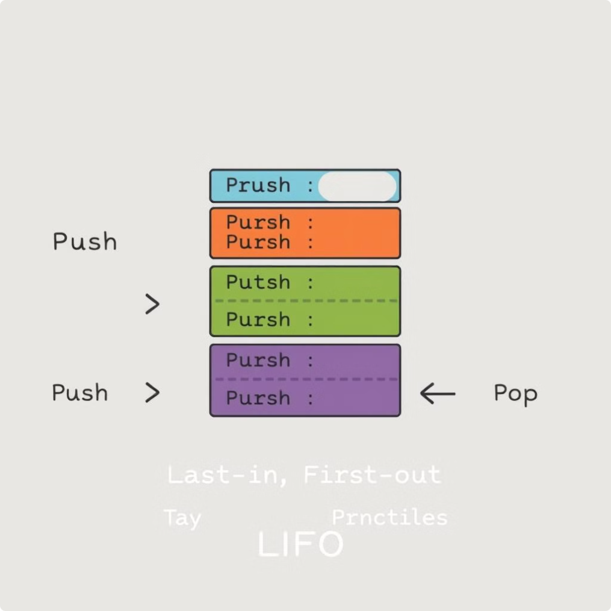
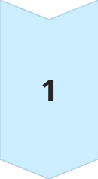
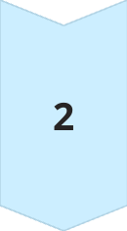
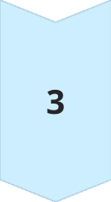
Stacks: The Last-In, First-Out Principle
Push Operation
The push operation adds a new element to the top of the stack, effectively "stacking" it on top of existing elements. The top element is always the last one added.
Pop Operation
The pop operation removes the top element from the stack. This is also known as "unstacking" the topmost element, making the element below it the new top.
Peek Operation
The peek operation allows access to the top element of the stack without removing it. This operation is helpful for inspecting the most recently added element without modifying the stack.

Slide 5

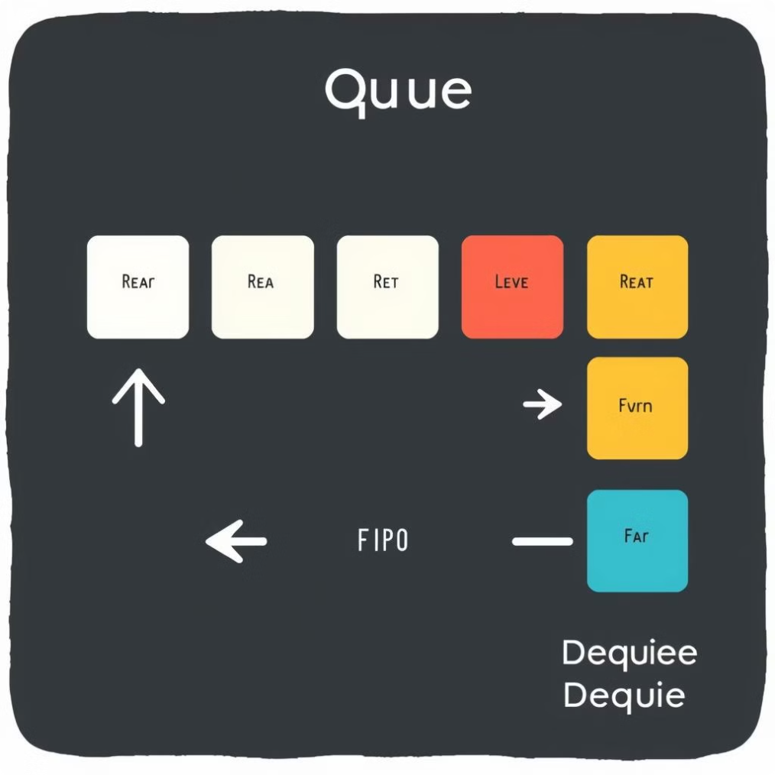
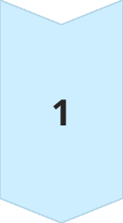
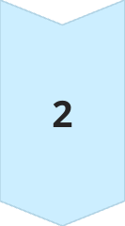
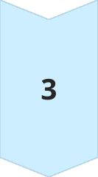
Queues: Handling Elements in Order
Enqueue Operation
The enqueue operation adds a new element to the rear of the queue, placing it at the end of the existing elements. New elements are always added to the back of the queue.
Dequeue Operation
The dequeue operation removes the element at the front of the queue. This operation follows the First-In, First-Out (FIFO) principle, ensuring that the oldest element is removed first.
Peek Operation
The peek operation allows access to the front element of the queue without removing it. This is helpful for examining the oldest element in the queue without altering its structure.

Slide 6
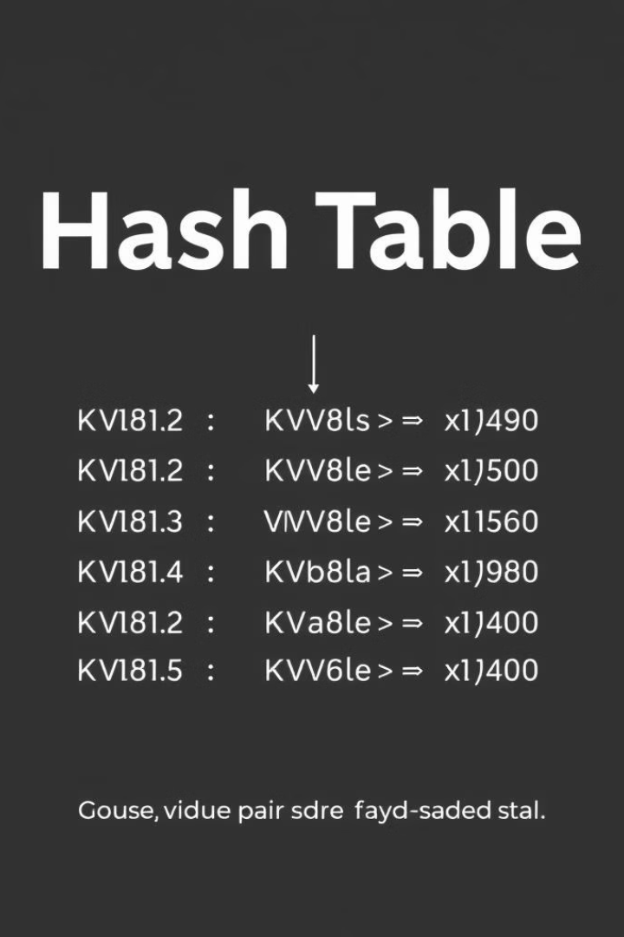
Hash Tables: Key-Value Storage with Fast Lookup
Operation
Description
Average Complexity
Worst-Case Complexity
Insert
Adds a key-value pair to the hash table.
O(1)
O(n)
Search
Retrieves the value associated with a given key.
O(1)
O(n)
Delete
Removes the key-value pair associated with a given key.
O(1)
O(n)

Slide 7
Trees: Hierarchical Data Organization
Binary Search Tree
Traversals
Applications
Binary search trees (BST) are a type of tree where each node has at most two children, a left child, and a right child. The left subtree of a node contains values less than the node's value, while the right subtree contains values greater than the node's value. This ordering allows for efficient searching, insertion, and deletion of elements.
There are three common ways to traverse a tree: In-order traversal visits nodes in ascending order (left, root, right), Pre-order traversal visits the root node first (root, left, right), and Post-order traversal visits the root node last (left, right, root).
Trees are widely used in many applications, including databases, file systems, and data compression algorithms. They are also essential for representing hierarchical structures and relationships, making them valuable in decision trees, expression trees, and game AI.

Slide 8



Graphs: Networks of Connections
Vertices and Edges
Search Algorithms
Applications
Graphs consist of nodes called vertices, connected by lines called edges. Edges can be directed or undirected, indicating a one-way or two-way relationship between vertices. For example, a social network can be represented as a graph, with users as vertices and friendships as edges.
Two common search algorithms for graphs are Breadth-First Search (BFS) and Depth-First Search (DFS). BFS explores vertices level by level, while DFS explores all paths from a starting vertex before moving to the next level. These algorithms are essential for finding paths, cycles, and connected components in a graph.
Graphs are used in various applications, including social networks, transportation networks, map navigation, and communication networks. They model relationships between entities, enabling efficient analysis of connections, paths, and flows within complex systems.

Slide 9

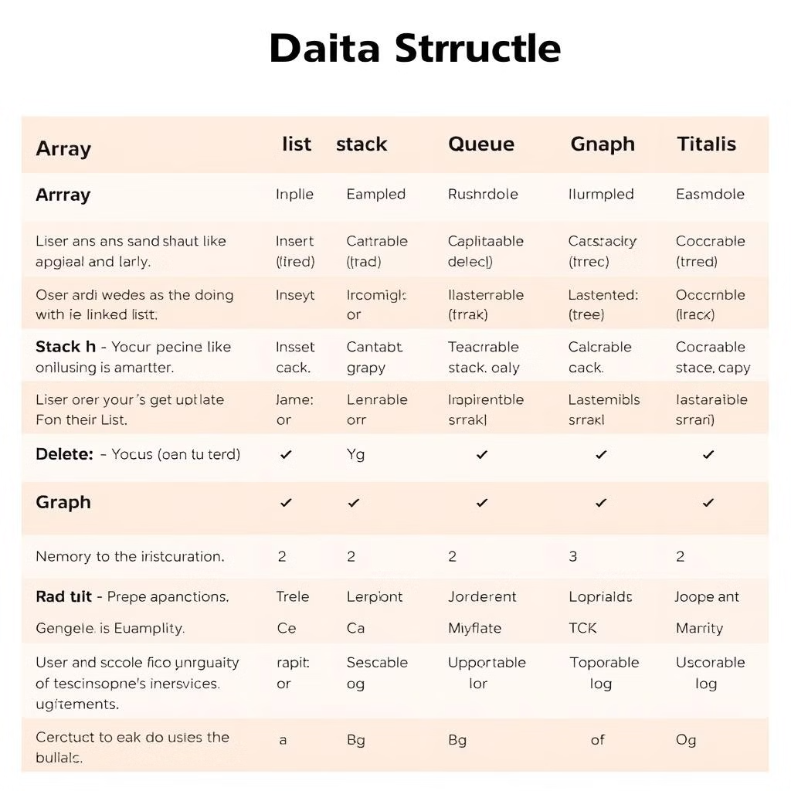
Data Structure Choices: Finding the Right Fit
Data Structure
Best for
Considerations
Arrays
Fast random access, sequential data
Fixed size, slow insertion/deletion
Linked Lists
Dynamic size, frequent insertion/deletion
Slower random access, additional memory for pointers
Stacks
LIFO operations, undo/redo, function call stacks
Limited access to elements except the top
Queues
FIFO operations, task scheduling, message queues
Limited access to elements except the front
Hash Tables
Fast key-value lookup, databases, caches
Potential collisions, memory overhead for hash function
Trees
Hierarchical data, searching, sorting, data compression
Balancing required for efficiency, recursive operations
Graphs
Networks, relationships, paths, social networks, maps
Complex traversal algorithms, potential memory overhead

Slide 10

Mastering Data Structures: A Continuous Journey
Understanding and implementing various data structures is a crucial step in becoming a proficient programmer. While this presentation provided an overview, the journey of data structure mastery is ongoing. Continuous learning and practice are essential for expanding your knowledge and applying these concepts to create efficient and effective solutions for complex problems. Remember, the more you explore, the more you discover, and the more you build, the more you grow.

Slide 11

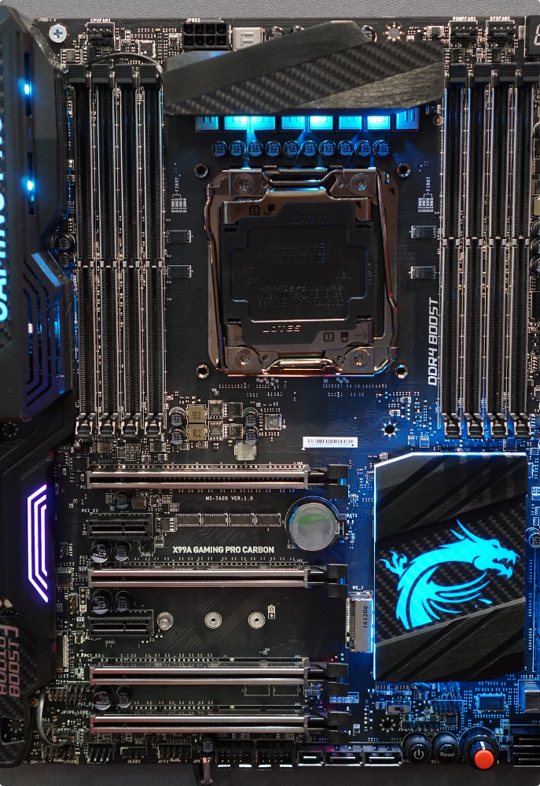
Memory Stack: A Fundamental Data Structure
The memory stack is a vital concept in computer programming, serving as the foundation for efficient function call management and the creation of temporary data storage. It operates on a Last In, First Out (LIFO) principle, ensuring that the most recently added element is the first one removed. This structure enables a well-organized control flow in programs, handling nested functions, recursive calls, and temporary variable storage with ease.

Slide 12


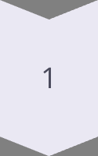
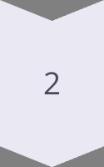
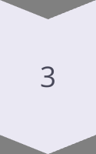
The LIFO Principle: Last In, First Out
Imagine a stack of books. The last book you put on the stack is the first one you remove. This is the essence of the LIFO principle, and it forms the basis of the memory stack's operations.
Push
Adding a new element to the top of the stack.
Pop
Removing the top element from the stack.
Peek
Viewing the top element without removing it.

Slide 13


Key Operations of a Memory Stack
The memory stack utilizes a set of essential operations to manage data efficiently. These operations are crucial for maintaining the integrity of the stack and ensuring smooth program execution.
1
Push
Adds a new element to the top of the stack. This element can be a function parameter, local variable, or a return address.
2
Pop
Removes the top element from the stack, effectively reversing the push operation.
3
Peek
Allows viewing the top element of the stack without removing it, providing access to the most recent data.
4
isEmpty
Checks whether the stack is empty, preventing potential errors caused by trying to pop from an empty stack.

Slide 14
Function Call Implementation: The Memory Stack's Role
The memory stack is central to the execution of function calls, ensuring a smooth and predictable flow of program control. Each function call creates a new stack frame, a dedicated block of memory that contains information essential for function execution.
Push Return Address
1
The memory address of the instruction after the function call is pushed onto the stack. This ensures the program can return to the correct point after the function finishes.
2
Push Parameters
Function arguments are pushed onto the stack, providing the function with the data it needs to execute.
Allocate Local Variables
3
The stack allocates memory space for local variables used within the function.
4
Execute Function
The function executes, accessing the parameters and local variables from the stack.
Pop the Stack
5
After the function finishes, the stack pops the local variables, parameters, and return address, restoring the program's state and resuming execution at the calling function.

Slide 15
Stack Frames: Organizing Function Calls
Each function call creates a stack frame, a distinct unit within the memory stack that encapsulates information relevant to that function. These frames act as containers for the data required during function execution, ensuring a well-defined and organized execution environment.
Return Address
Function Parameters
Local Variables
The memory address of the instruction that should be executed after the current function finishes, enabling the program to return to the correct place.
The values passed to the function as arguments, providing the function with the data it needs to perform its operations.
Variables declared within the function, acting as temporary storage locations for data used only within the function's scope.

Slide 16

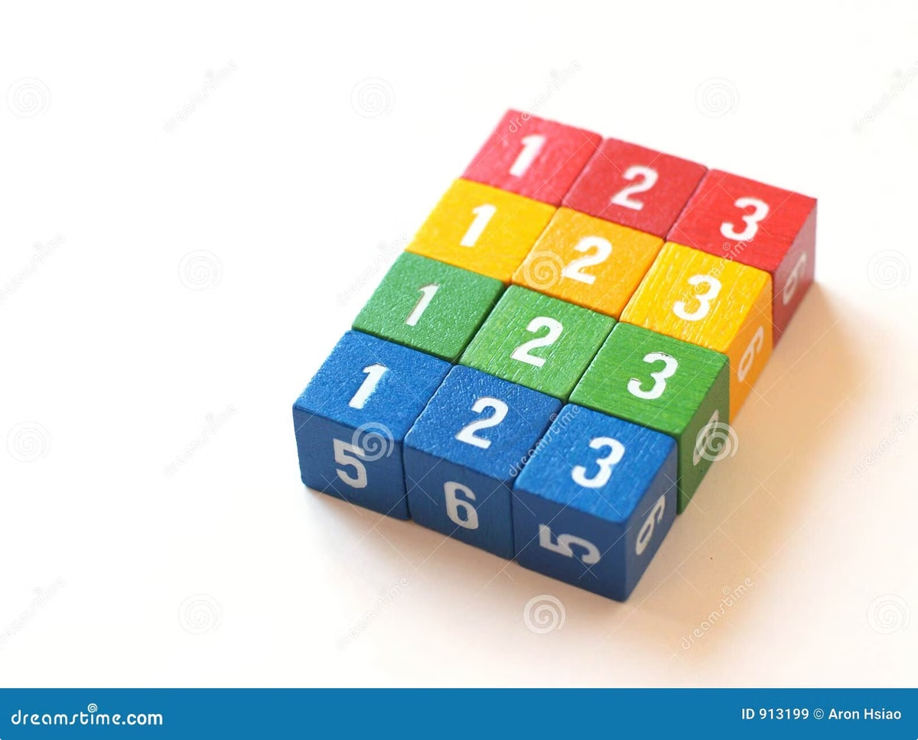
Visualizing Stack Frames: An Example
Let's illustrate the concept of stack frames with a simple example of two functions, functionA() and functionB(). Each function has its own dedicated stack frame, which is created and managed during the execution of the functions.
Function
Stack Frame
Description
functionA()
Return Address, x = 10
Contains the return address and the local variable x, initialized to 10.
functionB()
Return Address, y = 10, z = 15
Contains the return address, parameter y (passed from functionA), and the local variable z, calculated within functionB.

Slide 17




The Importance of Memory Stacks
Memory stacks play a crucial role in ensuring efficient and reliable program execution. They enable a well-organized control flow, efficient memory management, and the support of essential programming features like recursion.
Memory Efficiency
Function Call Management
Control Flow
Recursion Support
Stacks allow for dynamic allocation and deallocation of memory, ensuring that space is only used when needed and freed up promptly after function execution.
Stacks enable a structured control flow in programs, ensuring that functions return to their correct caller and that the program's execution follows a well-defined path.
Stacks are essential for handling recursive functions, where each recursive call creates a new stack frame, preserving the state of each recursive call.
Stacks effectively manage nested function calls, ensuring that the correct return addresses and local states are maintained, preventing errors and ensuring predictable program behavior.

Slide 18


Stack Overflow: A Potential Issue
While memory stacks offer numerous advantages, they are not without limitations. One potential issue is stack overflow, a condition that arises when the stack exceeds its allocated memory limit. This can occur when a program calls too many functions or if a recursive function calls itself too deeply, exceeding the available stack space.
Infinite Loops
Deep Function Calls
A recursive function that lacks a proper exit condition can repeatedly call itself, leading to an uncontrolled growth of the stack.
Programs with deeply nested function calls can consume significant stack space, potentially leading to overflow if the depth of the nesting exceeds the stack's limit.

Slide 19

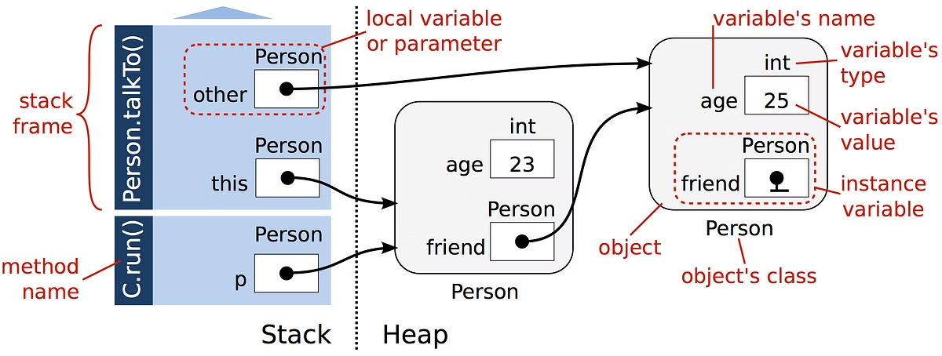
Stack vs. Heap: Understanding the Difference
The memory stack is just one aspect of memory management. It's important to understand the difference between the stack and the heap, two distinct areas of memory used for storing data.
Feature
Stack
Heap
Allocation
Automatic
Manual (using dynamic memory allocation)
Data Type
Local variables, function parameters, return addresses
Objects, dynamically allocated arrays, user-defined data structures
Access Speed
Faster
Slower
Lifetime
Short (function call lifetime)
Longer (until explicitly deallocated)

Slide 20
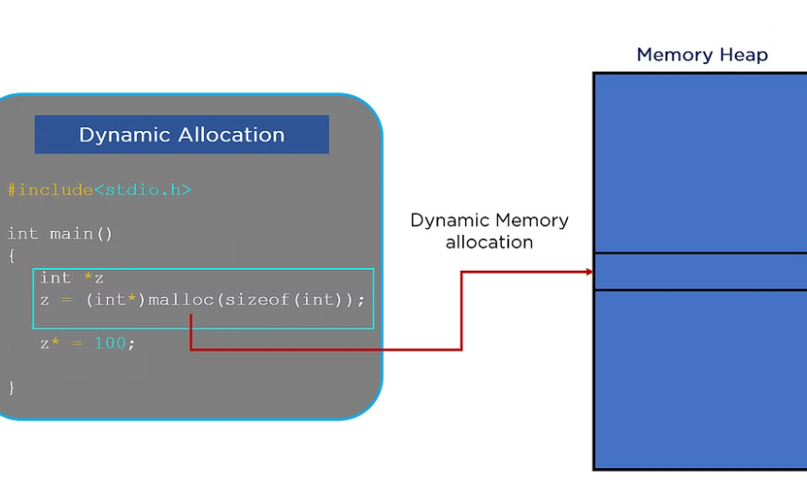

Memory Management Techniques
Understanding the memory stack is a crucial step in mastering memory management techniques. It helps you write efficient and reliable code, optimizing the use of memory resources and minimizing potential errors related to memory allocation and deallocation.
Dynamic Memory Allocation
Garbage Collection
A technique that allows programs to request memory dynamically during execution, enabling flexible allocation of memory for data structures of varying sizes.
A process that automatically identifies and reclaims unused memory, simplifying memory management and reducing the risk of memory leaks.

Slide 21


FIFO (First In, First Out) Queue: A Fundamental Data Structure
In the realm of computer science, data structures play a vital role in organizing and managing information efficiently. One such fundamental data structure is the FIFO queue, which follows a simple yet powerful principle: the first element added is the first one to be removed. This concept of "first in, first out" is ubiquitous in real-world scenarios, from task scheduling to customer service lines.

Slide 22
The FIFO Principle: A Foundation for Order
The FIFO principle is based on the concept of a queue, where elements are added and removed in a specific sequence. Imagine a line of people waiting to buy tickets at a movie theater. The first person in line is the first one to get their ticket, followed by the next person in line, and so on. This orderly process of adding and removing elements is the essence of a FIFO queue.
1
Orderly Processing
2
Real-World Examples
3
Efficiency
FIFO queues ensure that elements are processed in the order they were received. This is crucial for applications where fairness and order are paramount.
From managing customer service calls to processing tasks in a multi-tasking operating system, FIFO queues find widespread use in various applications.
FIFO queues streamline processes by ensuring that tasks are completed in a predictable and consistent manner. This results in efficient resource allocation and optimized performance.

Slide 23
Structure of a FIFO Queue: Building Blocks of Order
At its core, a FIFO queue comprises two fundamental operations: enqueue and dequeue. The enqueue operation adds a new element to the rear (end) of the queue, while the dequeue operation removes the element from the front (beginning). To manage these operations effectively, queues utilize two pointers:
Front
Rear
The front pointer always points to the first element in the queue, which is the next element to be dequeued.
The rear pointer points to the last element in the queue, where new elements are added.

Slide 24
Array-Based Implementation: A Practical Approach
One common way to implement a FIFO queue is using an array. In this approach, a fixed-size array is used to store the elements. To ensure efficient space utilization, circular indexing is employed, allowing the queue to "wrap around" when it reaches the end of the array.
1
2
3
Initialization
Enqueue
Dequeue
A fixed-size array is created, along with pointers for the front and rear. The queue is initially empty.
To add a new element, the rear pointer is moved to the next available position in the array. The new element is then inserted at this location.
To remove an element, the element at the front pointer is retrieved. The front pointer is then moved to the next position in the array.

Slide 25
Example Code: Bringing the Concept to Life
Here's a Java implementation of a FIFO queue using an array, showcasing the enqueue and dequeue operations:
java class ArrayQueue { private int[] queue; private int front, rear, size, capacity; public ArrayQueue(int capacity) { this.capacity = capacity; this.queue = new int[capacity]; this.front = this.size = 0; this.rear = capacity - 1;} // Check if the queue is full public boolean isFull() { return size == capacity;} // Check if the queue is empty public boolean isEmpty() { return size == 0;} // Enqueue operation public void enqueue(int item) { if (isFull()) { System.out.println("Queue is full"); return;} this.rear = (this.rear + 1) % this.capacity; this.queue[this.rear] = item; this.size++;} // Dequeue operation public int dequeue() { if (isEmpty()) { System.out.println("Queue is empty"); return Integer.MIN_VALUE;} int item = this.queue[this.front]; this.front = (this.front + 1) % this.capacity; this.size--; return item; } }

Slide 26



Linked List-Based Implementation: Dynamic Resizing
While array-based implementations offer a straightforward approach, linked list-based queues provide a more dynamic solution. In this approach, each element is stored in a node, and each node points to the next node in the queue. This dynamic structure allows the queue to grow or shrink as needed, eliminating the fixed size limitations of arrays.
Nodes
Pointers
Dynamic Resizing
Each element in the linked list is stored in a node, containing the data value and a pointer to the next node.
Pointers link the nodes together, forming a chain. The front pointer points to the first node, while the rear pointer points to the last node.
The linked list structure allows the queue to dynamically resize, adding or removing nodes as required.

Slide 27
Example Code: Linked List Implementation
Here's a Java implementation of a FIFO queue using a linked list:
class Node { int value; Node next; public Node(int value) { this.value = value; this.next = null;}} class LinkedListQueue { private Node front, rear; public LinkedListQueue() { this.front = this.rear = null;} // Check if the queue is empty public boolean isEmpty() { return front == null;} // Enqueue operation public void enqueue(int item) { Node newNode = new Node(item); if (this.rear == null) { this.front = this.rear = newNode; return;} this.rear.next = newNode; this.rear = newNode; } // Dequeue operation public int dequeue() { if (isEmpty()) { System.out.println("Queue is empty"); return Integer.MIN_VALUE;} int item = this.front.value; this.front = this.front.next; if (this.front == null) { this.rear = null; } return item; } }

Slide 28


Concrete Example: A Bank Queue
Let's visualize how a FIFO queue works in a real-world scenario: imagine a queue at a bank. Customers arrive and join the queue, waiting their turn to be served by a teller. The first customer in line is the first one to be served, followed by the next customer, and so on.
Customer A
Arrives at the bank
Customer B
Arrives after Customer A
Customer C
Arrives after Customer B
Customer A
Is served by the teller
Customer B
Is served next
Customer C
Is served last

Slide 29
Example of Usage: Illustrating the Process
Here's a Java code snippet that simulates a bank queue using a linked list-based FIFO queue:
public class BankQueueExample { public static void main(String[] args) { LinkedListQueue bankQueue = new LinkedListQueue(); // Enqueue customers bankQueue.enqueue(1); // Customer 1 arrives bankQueue.enqueue(2); // Customer 2 arrives bankQueue.enqueue(3); // Customer 3 arrives // Serve customers System.out.println("Serving customer: " + bankQueue.dequeue()); // Serving Customer 1 System.out.println("Serving customer: " + bankQueue.dequeue()); // Serving Customer 2 // New customer arrives bankQueue.enqueue(4); // Customer 4 arrives System.out.println("Serving customer: " + bankQueue.dequeue()); // Serving Customer 3 System.out.println("Serving customer: " + bankQueue.dequeue()); // Serving Customer 4 } }

Slide 30


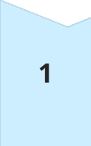
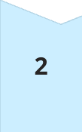
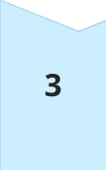
Advantages and Applications of FIFO Queues
FIFO queues offer a number of advantages, making them suitable for various applications:
Fairness and Order
They ensure fair and orderly processing of elements, crucial in scenarios like scheduling tasks or managing customer service calls.
Efficiency and Resource Optimization
They streamline processes by ensuring that elements are processed in a predictable manner, leading to efficient resource allocation and optimal performance.
Real-World Use Cases
FIFO queues are widely used in tasks such as operating system scheduling, networking data packet management, and customer service systems. They are essential for maintaining order and efficiency in various applications.

Slide 31


A Deep Dive into Sorting Algorithms: Quick Sort vs. Merge Sort
The world of computer science relies heavily on efficient sorting algorithms, and among these, Quick Sort and Merge Sort stand out as powerful contenders. Both algorithms leverage the "divide and conquer" strategy to achieve sorted arrays, but they differ in their approach to partitioning and merging the data. This presentation will explore the complexities and nuances of these algorithms, comparing their performance characteristics to help you make informed decisions for your sorting needs.

Slide 32
Quick Sort: The Principle of Divide and Conquer
Partitioning
Quick Sort starts by choosing a pivot element within the array. The array is then partitioned around this pivot, placing all elements smaller than the pivot to its left and larger elements to its right. This division creates two sub-arrays, one containing elements less than the pivot and the other containing elements greater than the pivot.
Merging
Finally, the sorted sub-arrays are merged back together in ascending order to form the complete sorted array.
1
2
3
Recursion
The partitioning process is recursively applied to the sub-arrays. The algorithm continues dividing the array into smaller sub-arrays until each sub-array contains only one element. At this point, the sub-arrays are inherently sorted.

Slide 33
Merge Sort: A Recursive Approach to Sorting
Merge
The core of Merge Sort lies in the merge operation. It takes two sorted sub-arrays as input and creates a single sorted array by comparing elements from each sub-array and placing the smaller element into the output array. This merging step ensures that the final array is sorted.
Divide
Merge Sort repeatedly divides the input array in half. This division continues recursively until each sub-array contains only one element. An array with a single element is inherently sorted.
1
2
3
Conquer
Once the array is divided into individual elements, the algorithm recursively merges the sub-arrays in sorted order. Two sorted sub-arrays are merged by comparing their elements, and the smaller element is placed in the merged array. This process continues until all elements are merged into a single sorted array.

Slide 34


Time Complexity: A Measure of Efficiency
Feature
Quick Sort
Merge Sort
Best Case
𝑂 ( 𝑛 log ⁡ 𝑛 ) O(nlogn)
𝑂 ( 𝑛 log ⁡ 𝑛 ) O(nlogn)
Average Case
𝑂 ( 𝑛 log ⁡ 𝑛 ) O(nlogn)
𝑂 ( 𝑛 log ⁡ 𝑛 ) O(nlogn)
Worst Case
𝑂 ( 𝑛 2 ) O(n 2 )
𝑂 ( 𝑛 log ⁡ 𝑛 ) O(nlogn)

Slide 35
Understanding the Impact of Pivot Selection in Quick Sort
1
Best Case Scenario
2
Worst Case Scenario
3
Average Case Performance
When the pivot element splits the array into nearly equal halves at each step, Quick Sort achieves optimal performance, resulting in a time complexity of 𝑂 ( 𝑛 log ⁡ 𝑛 ) O(nlogn). This occurs when the pivot is chosen strategically or when the input data is already partially sorted.
The worst-case scenario arises when the pivot is consistently chosen as the smallest or largest element in the array. This leads to unbalanced partitions where one sub-array contains a single element, while the other contains the remaining elements. In this case, the time complexity degrades to 𝑂 ( 𝑛 2 ) O(n 2 ), making it inefficient for large datasets.
For random datasets, Quick Sort exhibits an average time complexity of 𝑂 ( 𝑛 log ⁡ 𝑛 ) O(nlogn). The selection of pivot elements typically leads to balanced partitions, ensuring the efficiency of the sorting process.

Slide 36
Space Complexity: Analyzing Memory Usage
Quick Sort
Merge Sort
Quick Sort, when implemented in-place, has a space complexity of 𝑂 ( log ⁡ 𝑛 ) O(logn). This is due to the recursion stack, which stores the function calls and their parameters. The depth of the recursion is proportional to the logarithm of the input array size, hence the space complexity.
Merge Sort has a space complexity of 𝑂 ( 𝑛 ) O(n) because it requires additional space for temporary arrays used during the merge process. This space is necessary to hold the elements from the two sub-arrays being merged. The size of these temporary arrays is directly proportional to the size of the input array, leading to the linear space complexity.

Slide 37

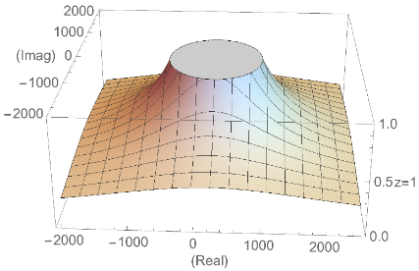
Stability: Maintaining the Order of Equal Elements
Quick Sort: Not Stable
Merge Sort: Stable
Quick Sort is not a stable sorting algorithm. This means that elements with equal values may not retain their original relative order after sorting. The instability arises from the swapping of elements based on the pivot, which can disrupt the original order of equal elements.
Merge Sort is a stable sorting algorithm. It preserves the relative order of equal elements during the merge process. This stability is achieved by copying elements from the two sorted sub-arrays in their original order. Equal elements are maintained in the output array in the same sequence as they appeared in the input array.

Slide 38

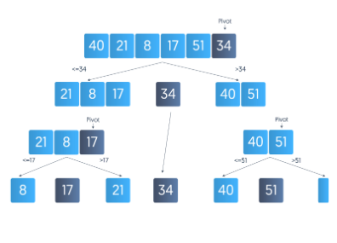



Quick Sort: Strengths and Applications
Speed
Memory Efficiency
Random Data
Quick Sort is generally faster than Merge Sort for average-case scenarios. It's particularly efficient for in-memory sorting of large datasets due to its low space overhead.
Quick Sort's in-place implementation minimizes memory usage, making it suitable for systems with limited memory.
Quick Sort excels in sorting random data, where pivot selection is less likely to lead to extreme imbalances.

Slide 39


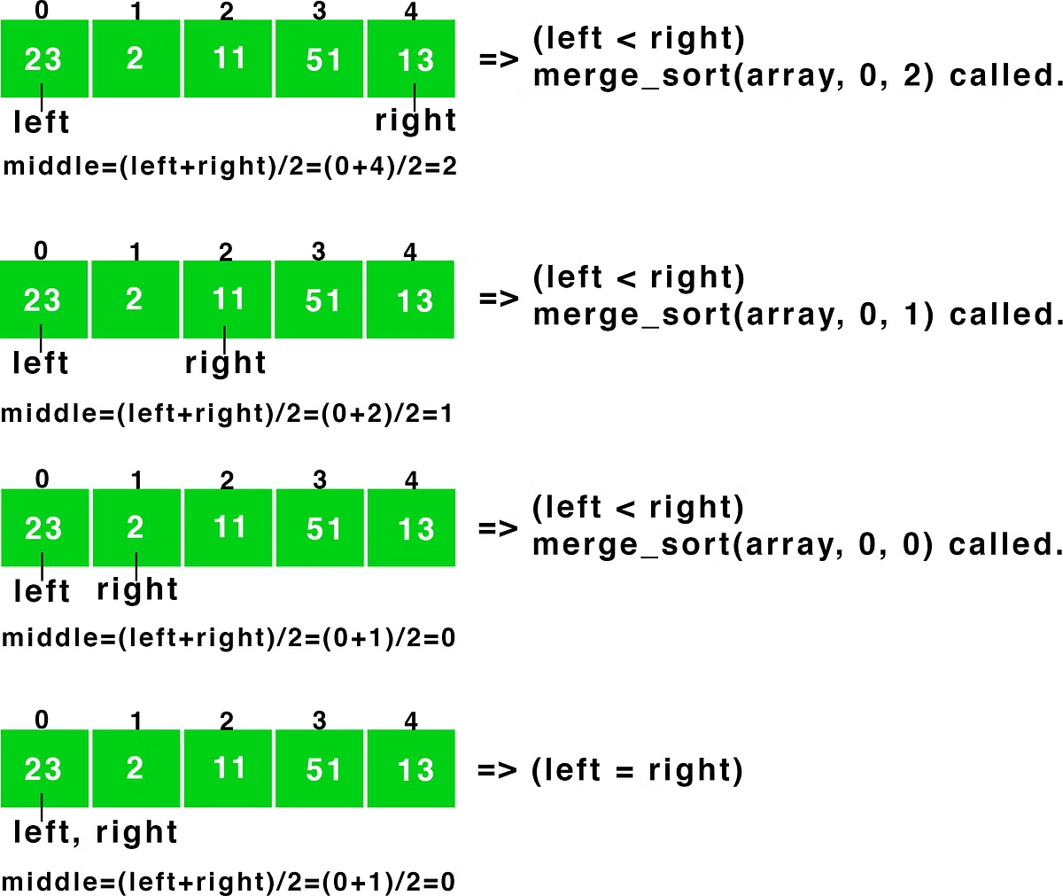


Merge Sort: When Stability Matters
Stability
Merge Sort's stability makes it ideal for applications where preserving the original order of equal elements is crucial.
Linked Lists
Merge Sort is well-suited for sorting linked lists because it does not require random access to elements, which is often limited in linked list structures.
External Sorting
For external sorting, where data is stored on disks, Merge Sort's efficiency in handling large datasets stored on disk is superior to Quick Sort.

Slide 40



Choosing the Right Algorithm for Your Needs
Quick Sort
Merge Sort
Conclusion
Quick Sort is typically the go-to choice for sorting large datasets in-memory. Its speed and in-place implementation make it efficient for random data. However, its instability can be a drawback in certain scenarios.
Merge Sort is the preferred option when stability is paramount. It excels in sorting linked lists and external data. While it requires additional memory, its consistent performance across different data distributions is its key advantage.
Understanding the strengths and limitations of both Quick Sort and Merge Sort empowers you to select the optimal algorithm for your specific needs, balancing speed, space, and stability considerations to achieve the best results for your sorting tasks.

